Slide 1
LASER HOME SECURITY
Sinhgad College of Engineering, Pune
Department of E&TC
T. E. E&TC - (Mini – Project)
Group No: A24
By
Chaitanya Waghmare T190233331
Kunal Chavan T190233061
Purushottam Deshmukh T190233068
Guide: Prof. A. D.Vidhate
2022-23, Sem: II

Slide 2
Contents
Introduction
Literature Survey
Aim and Objectives of mini project
Block Diagram
Circuit Diagram
Algorithm
Component with Specification
Result
References

Slide 3
Introduction
Need of security is the necessity of any individual. The feeling that we are safe and everything around us is all right is imperative for a peaceful living. LASER trip wire, which will be monitoring a walkway. Upon turning this on if anyone trips it or falls on the laser, an alarm will be raised, which might scare the trespasser.
The idea of LASER (Light amplification by stimulated emission of radiation) based security system with LDR (Light dependent resistor), in which an alarm was sounded when an intruder as detected.
LASER is highly directional and travels a very long range without losing sufficient power. LASER light even goes through long distance without scattering effect.

Slide 4
Literature Survey
Security could be the most important factor in daily life. Need of security is that the basic necessity of every individual. The Sensation/feeling that we are safe and everything around us is all right is imperative for peaceful living.
Be that because it may, during this unsafe world, when crime, terror, and dangers are at their pinnacle, how might one achieve that suspicion of safety? Here, a laser tripwire security system provides us with a solution and for this reason, more and more people are installing them to remain safe and secured.
Different electronic security systems are often utilized at the house and other significant working spots for security and safety purposes. A laser tripwire Security system/ alarm is a device used for Safeguard/security purposes.
When the bad guys try to sneak up in the mid night, they kick the wire and pull over, making a rattle that awakens the sleeping good guys, who win the day. A laser tripwire security system works with the identical principle and working.

Slide 5
Objectives
The system should be able to detect any unauthorized entry into the protected area. Laser sensors can be strategically placed to create a virtual perimeter, and when the laser beam is interrupted by an intruder, the system can trigger an alert.
When an intrusion is detected, the Arduino-based system can activate an audible alarm or trigger other warning devices such as flashing lights, sirens, or a pre-recorded voice message. The alarm should be loud and attention-grabbing to deter potential intruders and alert the occupants of the home or neighbors.
The system can send real-time notifications to the homeowner's smartphone or other connected devices, alerting them about the intrusion. This allows for immediate action, such as contacting the authorities or checking live surveillance camera feeds.

Slide 6
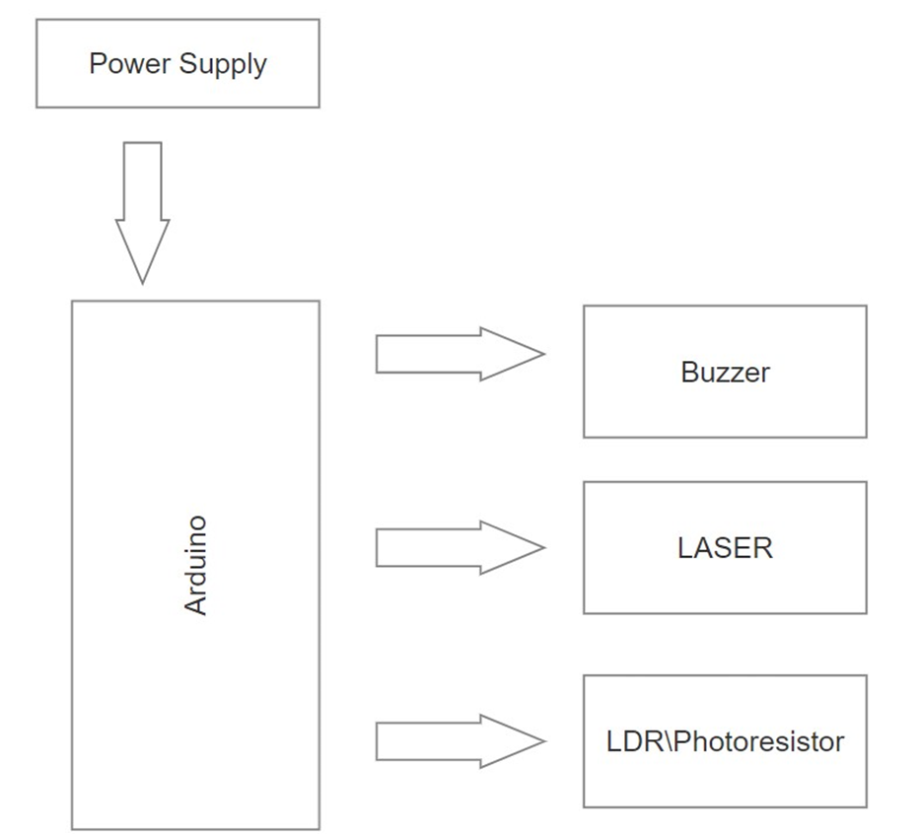
Block Diagram

Slide 7
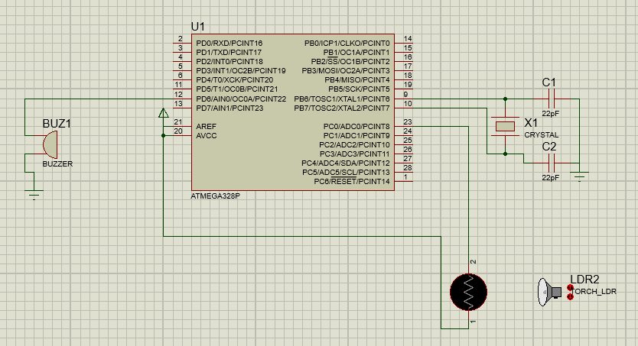
Circuit Diagram

Slide 8
Algorithm

Slide 9
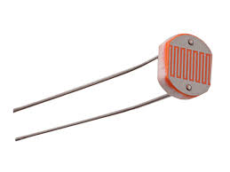
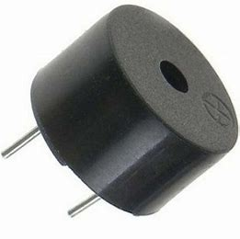
Components with Specification
LDR Model: Probots LDR Light Sensor Module Digital + Analog with Output Buy Online Buy Online India Description: Easy to install using the sensitive type photosensitive resistance sensor the comparator output signal gives a clean and good waveform. Driving ability is 15mA with the adjustable potentiometer, it can adjust the brightness of the light.
BUZZER: Buzzer (2-pin Active buzzer): Rated Voltage: 6V DC Operating Voltage: 4 to 8V DC Rated Current: ≤ 30mA

Slide 10
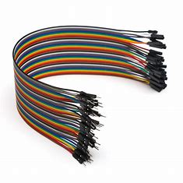
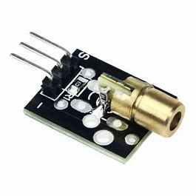
Components With Specification
Jumpers Wires: Jumper wires are electrical wires with connector pins at each end. They are used to connect two points in a circuit without soldering. You can use jumper wires to modify a circuit or diagnose problems in a circuit. Further, they are best used to bypass a part of the circuit that does not contain a resistor and is suspected to be bad.
Laser :Wavelength: 650nm(red) Operating Voltage: 5v Range: Unlimited (in vacuum) Current Draw: 30mA

Slide 11
Component With Specification
Arduino Uno: The Arduino UNO is the best board to get started with electronics and coding. If this is your first experience tinkering with the platform, the UNO is the most robust board you can start playing with. The UNO is the most used and documented board of the whole Arduino family.

Slide 12
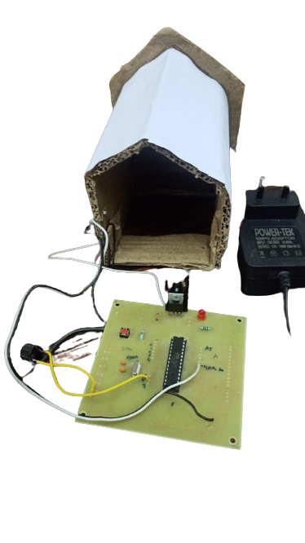
Result

Slide 13
Conclusion
To protect home and industry. Easy to construct, parts of the circuit are easily available. It reduced the man's effort. Accuracy of this circuit is more than accuracy of other circuits. The cost of circuit is low. They need very small power and voltage for its operation.

Slide 14
Future Scope
This security system is used in safeguarding bank vaults, museums, lockers, military, and Homeland security.
Furthermore, if we add more sensers we can make a camera capture the intruder if he trips the tripwire clicking his photo.
Then after adding a module, we can then send that photo to a cell phone alerting the owner.

Slide 15
References
K.Govinda K. Sai Krishna Prasad Sai ram susheel, Intrusion Detection System for Smart Home using Laser Rays, SCSE, University, Vellore, India, SENSE, VIT University Vellore, India. IJSRD - International Journal for Scientific Research & Development| Vol. 2, Issue 03, 2014 | ISSN (online): 2321-0613
https://www.hunker.com/13419297/how-do-laser-security-systems-work
https://www.electronicshub.org/laser-security-system/

Slide 16
Thank You

